Slide 1

Ecological Experiments: Design and Implementation
Discuss with classmates: If you were able to study and design an experiment around anything under the umbrella of “ecology”, what would it be?

Slide 2
Introduction to Ecological Experimental Design
A structured approach to planning and conducting experiments.
Tests ecological hypotheses, ensuring the validity and reliability of results.
Fundamental for advancing ecological knowledge, informing conservation strategies, and guiding environmental policies.
Observations identify associations, experiments can identify causes
Notes:
ID causes by reducing error and bias

Slide 3

Research Questions and Hypotheses
Research Questions:
Identify gaps in existing literature to find unresolved issues.
Are specific, clear, and address ecological phenomena.
Are relevant and researchable.
Hypotheses:
Must be testable and falsifiable, making clear predictions.
Notes:
So this is one of the first things we do! We see something going on and we ask our questions and come up with hypotheses

Slide 4
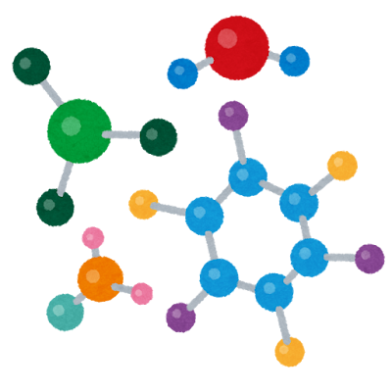

Research Questions and Hypotheses: Example
Concept: Elevated CO₂'s impact on plant growth rates.
Question: How does increased atmospheric CO₂ affect C₃ vs. C₄ plants?
Hypothesis: C₃ plants will show greater growth increases under elevated CO₂ than C₄ plants.
Rationale: C₃ plants use photosynthetic pathways that respond more to higher CO₂ levels.
Notes:
Most types of plants use a c3 pathway for photosynthesis, and some use a c4.
When we have our ideas set, we have to plan our experiment (often we are refining both things together though)

Slide 5

Types of Ecological Experiments
Manipulative Experiments
These involve altering one or more variables to observe the effects on an ecological system.
Example: applying varying levels of N fertilizer to grassland plots to assess response of plant species diversity and productivity.
Notes:
You are going in and changing something! You are the manipulator
sometimes these can be harder to do, think about a protected/endangered species or ecosystem!

Slide 6

Types of Ecological Experiments
Observational Studies
These involve examining natural systems without intervention.
Example: Monitoring coral reef health by assessing coral bleaching events and recording temperature, acidity, and species composition over time.
Notes:
These, you simply observe
Doesn’t necessarily mean you arent taking samples, but that you’re not Manipulating the ecosystem majorly

Slide 7

Types of Ecological Experiments
Natural Experiments
These take advantage of natural events or variations as experimental treatments.
Example: Comparing ecosystems before and after a volcanic eruption to study succession and species colonization.
Notes:
Super cool! But have to get lucky with the conditions sometimes
Other examples: peppered moth, cholera in London
How do we then set up these experiments? >>

Slide 8




Explanatory vs. Response
Response Variable: The variable whose distribution is of interest
Explanatory Variables: Variables that explain variability in the response variable.
I am studying the effects that increasing ocean temperatures have on coral reefs. I am taking measurements of sea surface temperatures and the percent of coral tissue that is bleached. What are the explanatory and response variables?
Notes:
Response variable AKA dependent, Y
Explanatory variable AKA independent, X
SST Explanatory, bleaching response

Slide 9

Factors and Treatments
Factor: Independent variable that you control, used as an explanatory variable. (General type or category of treatments.)
Levels are set by the experimenter
Treatment or Treatment Combination: A particular combination of the levels of all the treatment factors.
Different treatments constitute different levels of a factor
Administered to experimental units
Notes:
EXAMPLE:
Youre interested in plant growth. A factor could be “light availability”, and treatments could be “full sun”, “50% shade cloth”, “90% shade cloth”
NOTE: observational studies don’t have treatments in the exact same way as we aren’t manipulating anything. We can think about it as just having different levels of a factor or groups. Example could be insect abundance around roads. Factor would be distance from road, and Levels could be binned distance near/mid/far.

Slide 10
Controls and Control Treatments
Purpose: Provide a baseline to compare the effects of experimental treatments.
Account for external factors that could influence the results.
Types of Control Treatments:
Negative Controls: No experimental treatment is applied; conditions remain natural.
Positive/”Sham” Controls: A standard treatment known to produce an effect is applied to confirm that the experimental setup can detect effects.
Notes:
Maybe draw this on the board
Example: if I want to test the effects of compost or something I made on plants, I set up my experimental units (plots of plants) and then…
ASK: what could my negative control be? (plot where I put nothing)
And what could my positive control be? (plot where I put miraclegro/fertilizer thats definitely supposed to work) – if nothing happens in these plots, maybe something is wrong with my setup

Slide 11
Experimental Units and Sampling Design
Experimental units are the smallest divisions of the experimental material that receive different treatments.
They must be independent.
Smallest unit of inference.
The units or objects that are independently assigned to a specific experimental condition.
Experimental Error: variation among experimental units
Notes:
EXAMPLE: if you are investigating the effect of fertilizer on plant growth, and you have 10 plots – you apply fertilizer to the whole plot, your experimental units is the PLOT not the plants within the plots even if there’s 50 plants in each plot.
Now if you have 50 flowerpots and you put a plant in each one, now those are the experimental units because you will put a treatment onto them individually

Slide 12
Randomization and Blocking
In random sampling, each potential sampling unit has an equal chance of being selected.
This method reduces selection bias and enhances the representativeness of the sample.
Randomization Techniques: Randomization assigns treatments randomly to eliminate bias.
Methods include random number generators or drawing lots
Blocking Strategies: Blocking reduces variability by grouping similar units before randomization.
Identify factors (blocks) that could influence outcomes, then randomly assign treatments to blocks.
Notes:
We will talk more about sampling in a little bit!
Keep using field and plot example
Big field, divvy it up into plots, assign a number to each plot and draw straws to see which plot gets which treatment
What if there’s something different about the plots that you notice? Some sort of gradient in the field that you can’t necessarily control?
ASK: in this scenario, what could be something we can’t control?

Slide 13

Example: Crop Yield Experiment
In a crop yield experiment, plots are blocked by soil fertility (high, medium, low).
Could also be things like soil type, elevation, shade, etc.
Treatments (e.g., irrigation levels, fertilizer application, etc.) are randomly assigned within each block.
Outcome of Techniques: Randomization & blocking enhance reliability by controlling confounding variables.
Notes:
Speaking of counfounding variables: we had some in our lab last week! Oh dear! We wanted to test the effect of species on herbivory, but what are some things about the environment that we didn’t control for/that were different between the two?

Slide 14
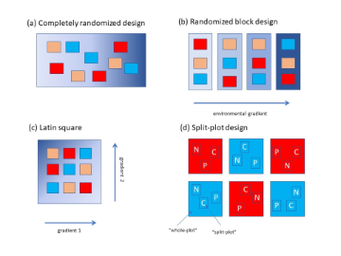
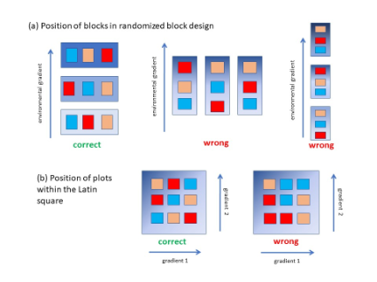
Understanding CRD vs. RBD
Notes:
Completely randomized design: just completely random. No attempt to block based on gradient.
• Pros: statistically robust
• Cons: with a small n, chance of all in a bad patch
EXAMPLE: you have a field with 18 plots and 3 fertilizer treatments and you assign a treatment to each plot completely randomly.
Randomlized block design: you have a gradient and block based on that assign “blocks” and then randomly assign treatment plot within the blocks
• Do not have to know if patches differ in quality
• Must have all treatment combinations in each block
EXAMPLE: maybe you have a known environmental gradient (one end of the field is more wet and the other is more dry), you would create blocks and assign each fertilizer treatment randomly within the block
You can see the blocks on the right haven’t been made correctly because you can see the strong gradient within the blocks
Latin square: you have 2 gradients (maybe like “moisture” and “light” or something like that) and you can create columns and rows. Each treatment should occur once in each column and once in each row (may be helpful to draw on board) – can clearly see why the “wrong” one on the right is wrong
Split-plot is where you have larger variables that are harder to change at the whole plot level and smaller variables that are easier to change at the split plot level. More on split plots here: https://www.stat.purdue.edu/~zhanghao/STAT514/Lecture_Notes/LectureNotes20-Split-plot-Designs-.html

Slide 15
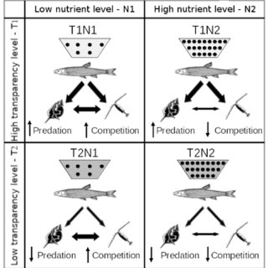
Understanding Factorial Designs
Factorial designs involve testing all possible combinations of levels of multiple factors
Benefits include efficiency in examining both individual and interaction effects of factors
Example: In studying the effects of pollution and temperature on aquatic life, researchers might test three pollution levels (None, Low, High) and two temperature levels (Normal, Elevated).
  3 x 2 design - 6 treatments
  Researchers can assess each factor individually on aquatic organisms, AND but also whether high pollution combined with elevated temperature leads to effects
Notes:
Difference between blocking and factorial?
Blocking is usually to control for a nuisance factor, aren’t usually looking to what the interaction between block and treatment are
• Increases generalizability, efficiency.
• Allows interactions to be detected

Slide 16
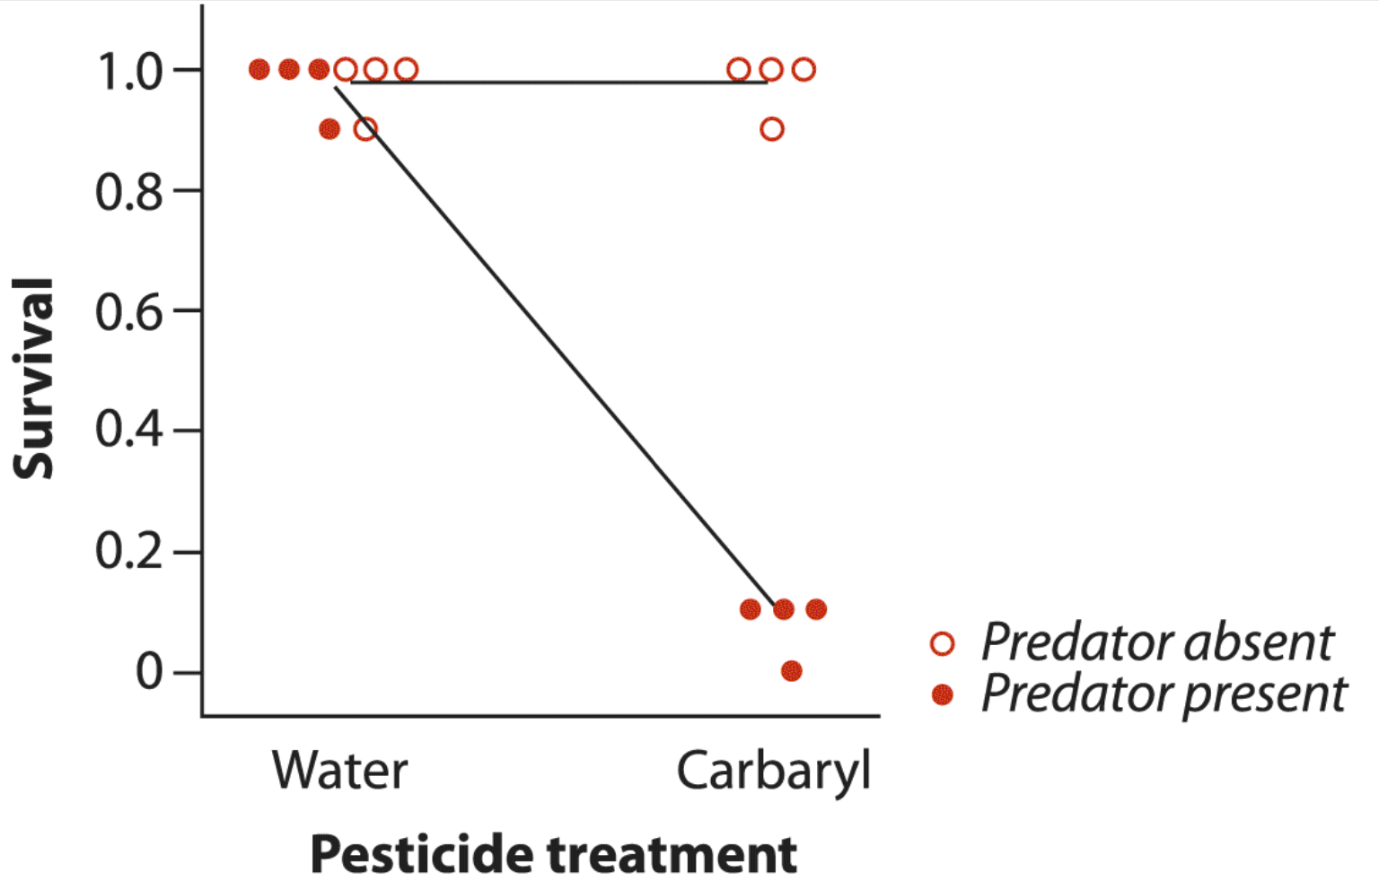
Factorial Treatments & Interactions
An interaction occurs when the effect of one treatment factor differs depending on the level at which the other treatment factor(s) are set.
Notes:
Example: the graph shows tadpole survival given different treatments. Interested in the combination of pesticide and predator presence. In this example the predator was caged, but visible to the tadpoles

Slide 17
Balance
A balanced experiment is one in which the replication is the same under each level of each experimental factor.
Increases power of experiment
Simplifies statistical analysis
E.g., an experiment with three treatment groups each with 10 experimental units is balanced; an experiment with three treatment groups of sizes 2, 18, and 10 is unbalanced.

Slide 18
Replication and Sample Size
Replication enhances the reliability of experimental results
Allows researchers to account for variability
Determining an appropriate sample size is essential and should be based on desired statistical power, effect size, and variability within the data.
Avoiding pseudoreplication is vital to ensure that experimental units are independent.
Pseudoreplication occurs when non-independent samples are treated as if they are independent
Example: In a stream pollution study, if researchers measure water quality at multiple points along a single stream and treat each measurement as an independent replicate, this is pseudoreplication.
  A better approach would be to sample multiple independent streams to provide valid comparisons.
Notes:
Could also be like. You measure the before/after heart rate of a scared animal every day for 7 days, and then you have 7 samples right? Well….

Slide 19

Temporal and Spatial Considerations
Understanding Temporal Dynamics: Ecological processes can vary significantly with time, influenced by seasonal changes, breeding cycles, and migration patterns.
Longitudinal studies help capture these temporal trends.
Exploring Spatial Heterogeneity: Microhabitats and landscape-level variability impact ecological interactions.
Different altitudes, latitudes, and fragmentation can create diverse ecological outcomes.
Notes:
Just things to think about!

Slide 20
Dealing with Environmental Variability
Minimizing Variability: Controlled environments, such as growth chambers, can be used to maintain constant conditions for experiments.
Selecting study sites with uniform environmental characteristics also helps reduce variability.
Measuring Environmental Variability: Regularly collect data on environmental factors such as temperature, humidity, and light levels.
This data can be recorded using automated sensors that provide continuous monitoring.
Example: Light Intensity on Algal Growth: To study the effects of light on algal growth, artificial lighting can be implemented to ensure consistent light intensity.
Alternatively, ambient light levels can be measured and included in statistical analyses.
Notes:
More things to think about!

Slide 21
Data Collection Methods
Standardizing Data Collection: Develop detailed protocols for data collection to ensure consistency and reliability across studies.
Instrumentation and Technology: Utilize advanced tools such as remote sensing and automated sensors for accurate environmental monitoring.
Example: Tracking Migratory Birds: Attach lightweight GPS tags to birds to gather precise data on migration patterns and behaviors.
Notes:
More things to think about!

Slide 22
Statistical Considerations
Designing for Statistical Analysis: Choose statistical tests that match the data type and experimental design.
Ensure data meets the assumptions of chosen tests, like normal distribution.
Consider the potential for Type I and Type II errors when selecting tests.
Performing Power Analysis: Power analysis helps determine the sample size needed to detect an effect.
Factors include desired statistical power, effect size, and variability.

Slide 23
Recall: Power
Power is the probability that a random sample taken from a population will, when analyzed, lead to rejection of a false null hypothesis.
Probability of detecting an effect that is indeed there!
Planning for power involves choosing a sample size that would have a high probability of rejecting H₀ if the absolute value of the difference between the means, | μ1−μ2 |, is at least as great as a specified value D.
Notes:
1-beta (probability of type 2 error) is power
Sometimes you may have to do this to justify proposed research
Minimum number of samples needed to see an effect
In ecology we might think ok we need at least that many
Animal ethics: use as few mice (etc.) as possible for humane reasons

Slide 24
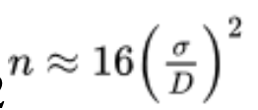
Power Analysis
A conventional power to aim for is 0.80. That is, if H₀ is false, we aim to demonstrate that it is false in 80% of the experiments.
Assuming a power of 0.80 and a conventional significance level of α=0.05, then a quick approximation to the planned sample size n in each of two groups:
Assumes that the two populations are normally distributed and have the same standard deviation (σ)
Notes:
Many different computer programs can do this calculation
https://stats.oarc.ucla.edu/other/mult-pkg/seminars/intro-power/
To get “population” number estimations you can do a literature review or pilot study, as a couple examples, this is where that D comes from. Effect size between 2 things.
Might try and do an example of this together on thurs!!

Slide 25
Case Studies in Ecological Experimentation
Hubbard Brook
Objective: Study the impact of deforestation on nutrient cycling and water quality.
Method: Clear-cutting a watershed and monitoring changes compared to untouched areas.
Findings: Increases in nutrient loss, such as nitrates, and water runoff were observed post-deforestation.
This highlighted the critical role of vegetation in regulating ecosystem processes.
Notes:
(Nitrate increased in streamwater)
https://hubbardbrook.org/experimental-watersheds-research-sites/watershed-2/

Slide 26
Case Studies in Ecological Experimentation
Tilman's Biodiversity Experiments
Objective: Investigate how plant diversity affects ecosystem functioning.
Method: Manipulating species richness in experimental plots and measuring productivity, nutrient retention, and resilience.
Findings: Plots with higher species diversity showed increased productivity and stability, providing empirical support for the importance of biodiversity in ecosystem health.
Notes:
Skim. This is just another case study

Slide 27
Case Studies in Ecological Experimentation
Lessons Learned
Successes: Demonstrated the value of long-term, large-scale experiments in ecology.
Challenges: Complexity of ecological systems requires careful experimental design to isolate effects.
Broader Implications: These case studies emphasize the interconnectedness of ecosystems and the necessity for informed conservation strategies.
Notes:
skim

Slide 28
Common Pitfalls and Best Practices
Avoiding Bias and Error: Be aware of confirmation bias, which can lead to overlooking data that contradicts your hypothesis.
Regularly calibrate instruments to prevent instrumental errors, and implement double-entry systems to reduce data entry errors.
Best Practices: Conduct pilot studies to refine methodologies before full-scale experiments.
Collaborate with statisticians during the design phase to ensure appropriate statistical methods are applied.
Future Directions: Explore emerging technologies such as machine learning for data analysis and environmental DNA (eDNA) for species detection.
Integrate interdisciplinary approaches to understand human-ecological interactions better.
Example: Citizen Science Projects: Programs like eBird and iNaturalist engage the public in recording species observations.
These initiatives expand data collection across wider spatial and temporal scales and require training participants in standardized data collection methods.
Notes:
SKIM

Slide 29


Introduction to Ecological Sampling
Ecological sampling methods help researchers understand ecosystems effectively!
These methods include random, systematic, stratified, transect, and quadrat sampling.
Each method serves specific applications for various ecological inquiries.
Notes:
Pause here for a break perhaps if there’s time

Slide 30

Why Sampling is Essential
Population censuses can be impractical and costly in large ecosystems.
Representative samples offer insights into population dynamics and trends.
Choosing the right sampling method reduces bias and improves accuracy.
Notes:
Remember week 1 where we were talking about our field grasshoppers? We can’t get the population of grasshoppers. We can take a sample though!

Slide 31
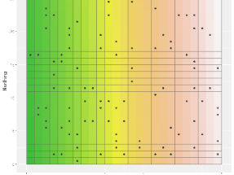
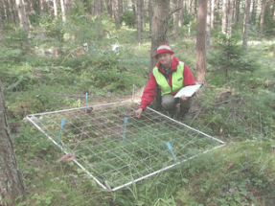
Random Sampling
Random sampling gives each individual an equal selection chance, reducing bias.
Example: For a plant diversity study, 10 quadrats are randomly placed in a hectare of grassland.

Slide 32
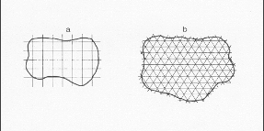

Systematic Sampling
Systematic sampling places units at regular intervals for even coverage.
Example: A benthic organism study collects samples every 10 meters along the shoreline.
Notes:
Randomly choose your starting point
Can be somewhat biased occasionally – could over or underrepresent a pattern present, so be careful
Good note: use when the item of interest could not possibly be aligned with the sampling pattern (e.g., don't take air samples every Monday morning if a nearby plant always pressure-cleans the duct work on Monday morning); https://www.epa.gov/quality/selecting-sampling-design#sg

Slide 33

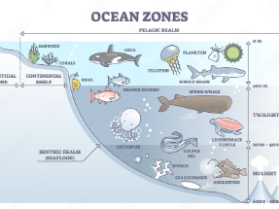
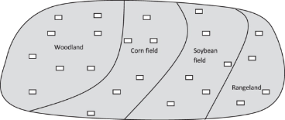
Stratified Sampling
Stratified sampling segments the area into habitats for complete representation.
Example: Researchers categorize a lake's zones by depth to evaluate fish populations accurately.
Notes:
In stratified sampling, the population is divided into subgroups (strata), and random samples are taken from each stratum.
This ensures that all subgroups are represented in the sample.

Slide 34
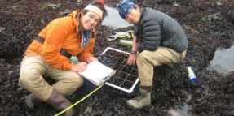
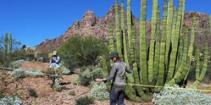
Transect Sampling Method
Transect sampling collects data along a straight line in a study area.
Example: In a rocky intertidal study, a 50-meter transect samples small quadrats for invertebrates every 5 meters.
Notes:
Not mutually exclusive with systematic sampling

Slide 35
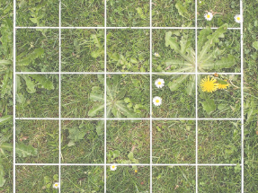
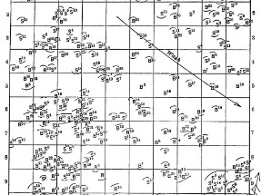
Quadrat Sampling Method
Quadrat sampling uses a frame to mark a sample area for study.
Randomly or systematically place quadrats, then count organisms inside each one.

Slide 36
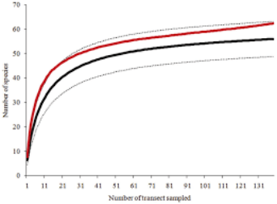
Considerations for Effective Sampling
Sample Size and Effort: Larger samples help capture rare species and improve estimate accuracy.
Species Accumulation Curves: Accumulation curves show the link between sampling effort and species count detected.
Common Sampling Biases: Biases like selection and temporal bias may result in inaccurate estimates. Proper planning helps.
Notes:
More samples are better, but we don’t have unlimited time or resources!
This is where the species accumulation curve comes in

Slide 37
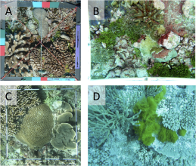

Case Study: Sampling Coral Reefs
A marine biologist uses transect sampling to evaluate coral health and fish diversity.
Transects are laid at 10 m, 20 m, and 30 m depths to collect data.
Along the transects, species abundance and composition within a 1m² quadrat is recorded every 5 meters.
Fish within 2.5m of the transect are recorded.
This reveals shifts in species composition and abundance with depth changes.
Notes:
ASK: have half of the room think about coral and half the room think about fish. Try to come up with some ways to sample these things!
Then I can show my “answers” (these would be the more conventional ways of doing things but surely not the only way – and you can always think of a new method and test it against something conventional!)

Slide 38
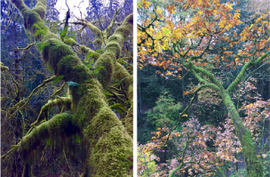

Case Study: Stratified Sampling in Rainforests
Ecologists studied biodiversity in tropical rainforests using stratified sampling methods.
They focused on different canopy layers: ground, mid-canopy, and upper canopy.
Dividing the forest into strata ensured each layer was represented. Results showed species richness was highest in the mid-canopy layer.

Slide 39
Organizing and Visualizing Ecological Data
Importance of Data Organization: Data organization and visualization are crucial in ecology as they facilitate the effective interpretation of complex ecological data, enabling researchers to identify patterns and relationships.
Common Data Types: Ecological data can be categorized into common types: categorical (fish names), numerical (individual counts), spatial (geographical coordinates), and temporal (e.g., time series data).
Challenges and Goals: The main challenges of data organization include handling errors, inconsistencies, and missing values.
Notes:
Skim

Slide 40
Data Cleaning and Preparation
Data cleaning involves identifying and correcting errors, inconsistencies, and missing values in datasets.
Data transformation includes standardizing, normalizing, and transforming data as needed, such as applying log transformations or square root transformations to meet analysis assumptions.
Handling Missing Values: Data imputation is a technique used to handle missing data. Common methods include mean imputation and regression imputation.
Importance of Preparation: Proper data cleaning and preparation are essential to facilitate accurate analysis and meaningful results in ecological research.
All actions during this process have to be documented.

Slide 41
Data Imputation
The process of replacing missing data with substituted values.
Mean Imputation: calculate the average of the non-missing values for your variable of interest, and substitute it for your missing values.
Regression Imputation: uses a model to predict missing values.
These are not without cons!
Notes:
More information here: https://libguides.princeton.edu/R-Missingdata , https://www.publichealth.columbia.edu/research/population-health-methods/missing-data-and-multiple-imputation
Example, one con of regression imputation is that there is no error. It fits perfectly on the regression line, which isn’t natural

Slide 42
Organizing and Managing Data
Data Structures: Understanding different data structures is crucial for effective data management.
Common structures include matrices, data frames, and databases.
Matrices are used for numerical data representation, while data frames allow mixed data types.
Data Storage and Metadata Management: Appropriate storage methods include CSV files, spreadsheets, and relational databases.
CSV files are simple text files that store data in a tabular format. Common and preferred.
Metadata management involves documenting data attributes, sources, and processing steps to enhance data usability. “Data about data.”
Notes:
Data frames are mostly what you’ll use in this class!

Slide 43
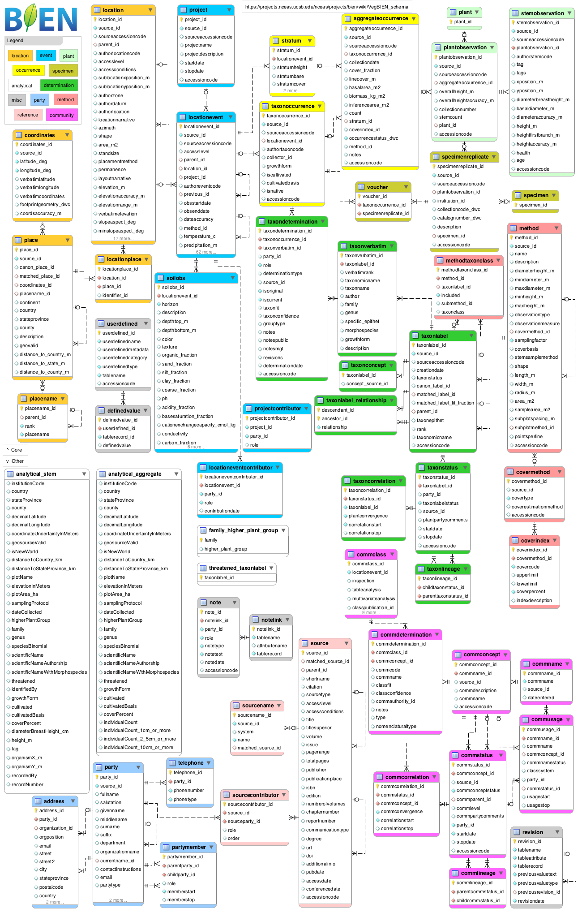
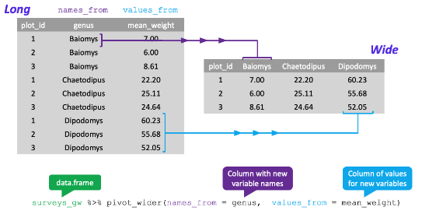
Data Frames & Databases
Notes:
Database from here: https://bien.nceas.ucsb.edu/bien/biendata/previous-bien-versions/bien-3/bien-3-schema/
Things get complicated fast!

Slide 44
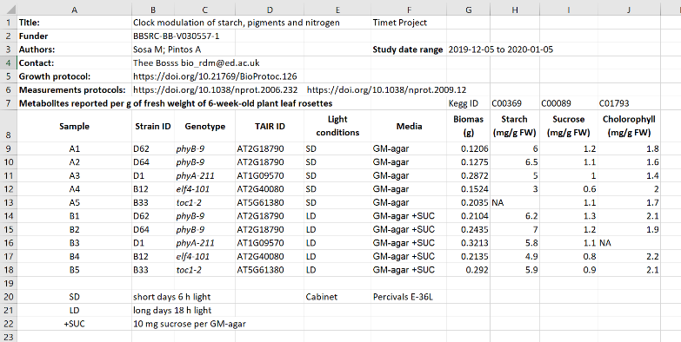
Metadata

Slide 45
Exploratory Data Analysis (EDA) Techniques
Summary Statistics: Calculate measures of central tendency such as mean, median, and mode, alongside measures of dispersion like variance and standard deviation.
Frequency Distributions: Visualize the distribution of data using techniques like histograms and bar charts.
Visualization Techniques: Utilize plots and graphs to explore data patterns, including scatter plots, line plots, and box plots.
Notes:
ASK: have you guys done some of this in this class and others? Absolutely!

Slide 46
Exploratory Data Analysis (EDA) Techniques
Explore Data Patterns: Employ visual methods to identify trends, outliers, and relationships within the dataset.
Correlation Analysis: Assess relationships between variables by employing methods such as Pearson correlation and Spearman correlation.
Importance of EDA: Critical for understanding data structure and informing further analyses and modeling choices.
Notes:
We will get to correlation next week ;-)

Slide 47
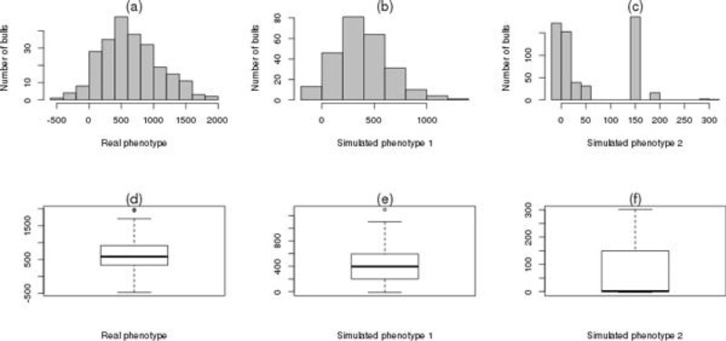
Histograms & Boxplots
Notes:
Histogram is graphical representation of frequency distribution
These should look familiar :-)

Slide 48
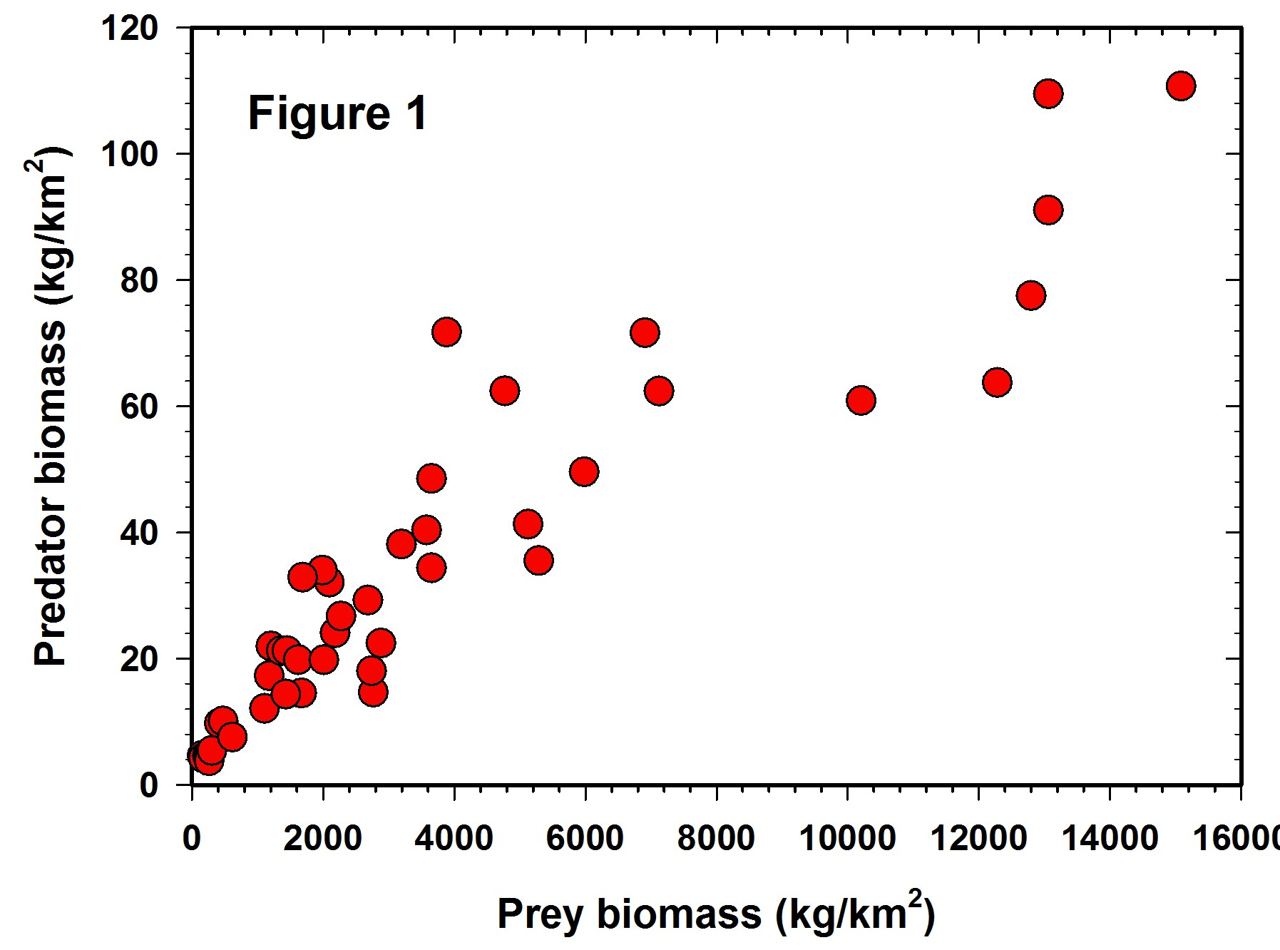
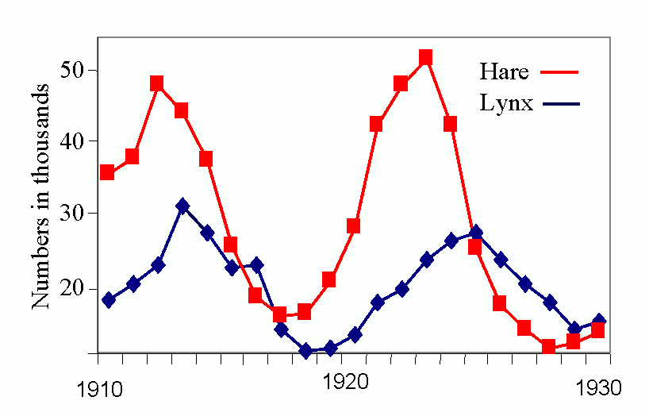
Scatterplots & Line Charts
Notes:
Relationship between two variables, change over time

Slide 49
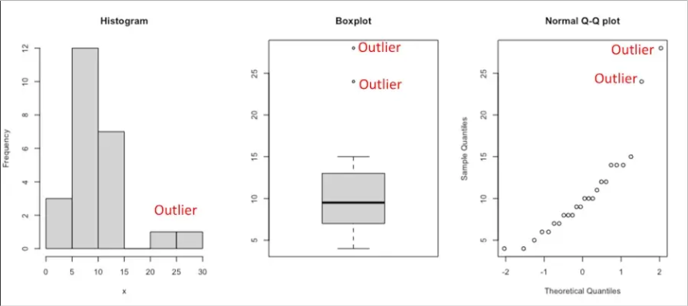
Visualizing Outliers
Notes:
Just making a quick plot can help you see if you have any!

Slide 50
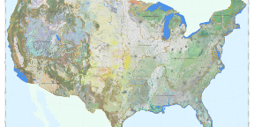
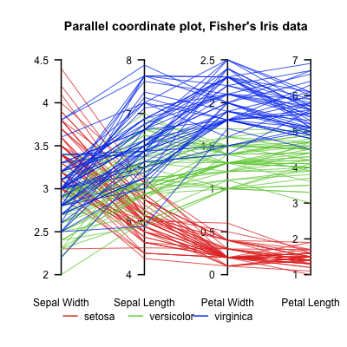
Visualizing Ecological Data
Spatial Data Visualization: Creating maps and spatial distributions using techniques such as choropleth maps and point maps enhances the understanding of ecological data across geographical areas.
Temporal Data Visualization: Plotting time series data, for instance, using line charts and time series analysis, allows for the examination of trends and changes over time in ecological metrics.
Multivariate Data Visualization: Representing multiple variables simultaneously through techniques like parallel coordinate plots and scatterplot matrices provides insights into complex ecological relationships.

Slide 51
Choosing Visualization Techniques
Data Type Consideration: Choosing the right visualization technique begins with understanding the data type. Common types include categorical, numerical, spatial, and temporal data, each requiring specific visualization approaches.
Research Question Alignment: The visualization must align with the research question. Determine what insights are needed and select techniques that effectively communicate those insights.
Clarity and Effectiveness: Emphasize clarity and effectiveness in visualizations. Use appropriate scales, labels, and legends.

Slide 52



Try it Yourself!
Four groups, four different scenarios. Not necessarily any right or wrong answers!

